Slide 1
2023 HPSP Statistics for Active Duty Military &
ROTC
Maj Elizabeth ”Lauren” Morris
Chief, Dental Education Section
AFPC/DPMND
5 June 2023

Slide 2


Health Professions Scholarship Program (HPSP)
AFIT pays for all dental school tuition, fees, books, equipment, etc
ARPC provides monthly stipend for living expenses
  $2,608.00/month
ADSC for HPSP:
  3 year Time in Service ADSC concurrent with
  1 year ADSC for each year of scholarship (i.e. 4-year ADSC for 4-year scholarship)
AEGD-1
  HPSP recipients must apply
  HPSP recipients must attend if selected (since FY15)
  Neutral year: Does not count towards ADSC, but does not incur additional ADSC
Requirements for entering Active Duty after HPSP:
  INBDE passing score, Dental school degree conferral, Challenge State licensure exam
Data is current as of July 2022
Notes:
Funding for the HPSP recipients comes from two sources. AFIT is responsible for the tuition expenses and the funding for the stipend comes from the reserves. The program pays for all tuition, books, equipment and fees as well as a monthly stipend which increases each year in July.
The active duty service commitment is year for year, however there is a minimum term of service for those individuals who might have a 2 year scholarship. We have scholarships out that are 2-4 years in length.
Under the terms of the past HPSP contract everyone was required to apply for the AEGD-1, but they were not obligated to accept a training offer. As of 2019, all HPSP scholarship recipients must apply for the AEGD-1 and must attend if selected.
For the 3 and 4 year scholarship recipients, the AEGD-1 is what we call a neutral year, meaning that it does not count as credit towards their service commitment and it does not incur an additional education ADSC.
Before entering active duty, the HPSP recipients must have passed both Part I and II of the National Board Exam or the Integrated National Board Exam, they must have completed all of their graduation requirements, and they must have, at a minimum, at least taken their licensure exam.

Slide 3
HPSP Application Timelines
Active Duty Only:
  1-year before you will separate from AD to attend dental school, approx. Aug, you will begin the voluntary separation process
December:
  HPSP application released by AFPC.DPMND.GraduateDentalEdu@us.af.mil
  Applicants should be applying to dental schools with an expectation of starting dental school the following summer
  Acceptance into dental school is not required to APPLY
  Acceptance into dental school is required to RECEIVE an HPSP scholarship
    If you are selected for HPSP but are not selected to attend dental school, the voluntary separation of an AD member would be null and void. It is contingent on acceptance into dental school

Slide 4
HPSP Application Timelines
Late Feb/March:
  HPSP application documents are due to AFPC/DPMND
March:
  HPSP Selection Board makes selections for the scholarship recipients
  Notifications of selections are sent out through Chain of Command
April:
  AFPC/DPMND assists the Selects in completing HPSP packages and contracts
  Completed packages are submitted to AFIT and ARPC for processing
  Final processing of active duty members cannot be complete until the member has separated
Summer:
  HPSP Selects separate from AD / ROTC and enter the IRR
  PCS to dental school

Slide 5
Health Professions Scholarship Program (HPSP)
AFRS HPSP board application requirements
  3-Yr: 18 DAT/3.5 GPA or 19 DAT/3.2 GPA
  4-Yr: 19 DAT/3.6 GPA or 20 DAT/3.4 GPA
  Waiver: Prior military AD service applicants do not require a minimum DAT score / GPA to apply
2023 board score averages:
 | DAT | GPA | Lowest GPA | Highest GPA
4-yr HPSP | 22 | 3.85 | 3.5 | 4.0
3-yr HPSP | 21 | 3.62 | 3.3 | 4.0
2-yr HPSP | 22.5 | 3.83 | 3.7 | 3.9
Data is current as of Feb 2023
Notes:
If someone is considering applying for the HPSP scholarship, the minimum DAT scores and GPA are listed here at the top. The exception to this is any applicant with prior service does not have to meet these minimum requirements. The bottom numbers are averages of scores from the 2023 board (current as of Feb 2023). If someone separates to complete their dental school pre-requisites, then they have to compete on the AFRS boards against these numbers to get an HPSP scholarship.
GPA/DAT score; Range. The bottom number in this range is always an outlier, and these applicants always had something that made their package stand out (previous AD, leadership, leading mission trip, something like that)

Slide 6
Health Professions Scholarship Program (HPSP)
AFPC HPSP board
  4-year (10) scholarships: ROTC (2), USAFA (2), currently Active Duty (6)
Acceptance rates AFPC vs AFRS
  AFPC: ~ 100% for 4 yr HPSP
  AFRS: ~ 30% HPSP overall
    ~ 12% for 4 yr HPSP
Data is current as of April 2023
Notes:
While prior service members don’t have to meet the minimums to apply, they do have to compete against people that have these high scores. Their chance of acceptance is a lot lower when applying through AFRS. At AFPC we do have 10 4-year HPSP scholarships that we can award to applicants from USAFA, active ROTC, and currently ADAF members who are accepted into dental school. AFPC wants to recognize members that are working full time jobs in military while attending school, and their chance of being competitive against civilians who are only attending college to get their prerequisites is much more slim. If they separate from the military to finish their pre-requisites, they cannot apply through AFPC anymore and have to compete against all the civilians applying for HPSP scholarships. Guard and reserve members must apply through AFRS as well.

Slide 7

Active Duty Interested in HPSP
Spread the Word
Required:
  Conditional release from Career Field Manager
  Meet criteria to be commissioned officer
  Acceptance letter from accredited dental school
  Current physical
  Worldwide qualified
Applications made through AFPC/DP2ND
  Released Dec prior year
  Board in March
Considers impact of Military Service to GPA/DAT
Notes:
Reach out to dental technicians and other career fields that would like to enter the AF Dental Corps. Many of the requirements have been waived for prior service members that would like to stay in the military as a dental officer. These members show increased retention due to previous “Blue-ing” or “Greening” from their earlier service time. Air Staff is working to make these scholarships available to Guard and Reserve personnel as well in the future.

Slide 8
Active Duty Interested in HPSP
Leadership needs to understand
  Some dental school pre-requisites are only offered during duty hours
  Some dental schools do not accept pre-requisites from online courses
  Some dental schools only accept pre-requisites from 4-year universities
Consider being creative to allow enlisted time to take these pre-requisites
  Modified schedules
  Early arrival
  Extra on call time
  Promote program/mentorship

Slide 9
Additional Information
While in dental school receiving the HPSP scholarship
  You commission as a 2nd Lt into the Inactive Ready Reserve (IRR) – this is not the traditional “Air Force Reserves”
  You are not eligible for ALL active duty benefits
    Think of this as a “Scholarship” that pays for your dental school with a stipend to help with additional costs
    You are not eligible for TriCare insurance, military healthcare, BAH, and BAS
    ROTC are not eligible for PCS reimbursements when moving TO dental school
After dental school graduation
  You commission as a Capt (O-3) on Active Duty
  If you have prior military service, your AD service is applied to your years to promotion/retirement/pay after your first 120 days back on AD
    You may meet promotion boards earlier than dental peers due to your prior military service
Data is current as of July 2022

Slide 10
Air Force Dental Careers
10 specialties & 14 sub-specialties
Three career pathways
  Clinical
  Academic
  Executive
Ability to move between various career pathways
Executive pathway progression for pinnacle positions
PME Completion (residence or distance learning) in line with Air Force expectations
5
Notes:
Professional Military Education: courses aimed at strengthening Air Force Officership appropriate for each rank (Capt through Lt Col).

Slide 11




Air Force Dental Careers
*Desired pin-on timing (ref. DoDI 1320.13). Years of commissioned military service
plus all entry grade credit.
Functional Area Experiences (CGO):
Clinical
  Solidify clinical knowledge/procedural skills
  Clinical Dentist / Specialist
  Deployments / Dental Readiness Training Exercises (DENTRETE) / Innovative Readiness Training (IRT)
Academic
  Resident, Residency Instructor, Deputy Program Director, Academic appointment
Executive
  Flight Commander, Element Chief/Ldr
Formal Education/Training:
AEGD-1, AEGD-2 and/or specialty residency
Board certification in specialty area (if eligible)
PME: PDE in line with AF expectations
Special Experiences:
International Health, Fellowships
Functional Area Experiences (FGO):
Clinical
  Clinical Dentist / Specialist
  Deployments / DENTRETE / IRT
Academic
  Program Director, Dental Researcher, Deputy Program Director, Residency Instructor, Academic appointment
Executive
  Sq/CC, CDS / Flt/CC, SG Consultant, Air Staff / AFMRA / Joint / DHA
Formal Education/Training:
AEGD-2 and/or Specialty residency
Board certification in specialty area (if eligible)
PME: IDE/SDE in line with AF expectations
Special Experiences:
International Health, Fellowship, HQ/MAJCOM support, Informatics, Public Health, SG Consultant, Air Staff / AFMRA / Joint / DHA
DE In-Residence
Functional Area Experiences (O-6):
Clinical
  Senior Clinical Dentist / Master Clinician
  Deployments / DENTRETE / IRT
Academic
  Program Director, Dental Researcher
Executive
  Flt / Sq / Group / MAJCOM / Air Staff / AFMRA/ Joint Staff Leadership, AF/SG Chief Consultant
Formal Education/Training:
Board certification/recertification (if eligible)
Medical Strategic Leadership Program, Joint Senior Medial Leadership Course, CAPSTONE
Special Experiences:
Joint leadership (including HA / DHA / COCOM)
Pinnacle positions appointed by the AF/SG
*Leadership inherent in all pathways (Clinical/Academic/Executive)
Notes:
This career progression chart highlights various positions that a dentist may hold at various ranks and skill levels within the 3 career pathways (C/A/E). A dentist does not have to only follow one career pathway – they may hold a clinical role at one assignment, serve in a more executive role at the next assignment, and return to a more clinical role at the following assignment.

Slide 12




Air Force Dental Careers
Foundational Prep
PME
Staff/Joint
Career Broadening (IHS, Readiness, DHA)
Command
C
Clinical
CLNICAL MENTOR
SDE
FELLOWSHIP,
SENIOR CLINICAL DENTIST
MASTER CLINICIAN
Academic
A
AEGD
CLINICAL COMPETENCE,
OFFICERSHIP,
SPECIALTY TRAINING
IDE
SPECIALTY TRAINING, RESIDENCY INSTRUCTOR / USUHS APPT
AEGD or
SPECIALTY DEPUTY DIRECTOR or PROGRAM DIRECTOR
AEGD or
SPECIALTY
PROGRAM DIRECTOR
SPECIALTY CONSULTANT
1 yr
PDE
E
8-10 yrs
SGD,
Flt/CC,
STAFF, or
CAREER- BROADENING TOUR
SGD,
STAFF,
Flt/CC, or
Sq/CC
Sq/CC
Gp/CD
Gp/CC,
MTF DIRECTOR, or
AIR / DHA / MAJCOM / COCOM STAFF
AIR, MAJCOM, COCOM, DHA STAFF
2-3 yrs
1 yr
6-8 yrs
2-4 yrs
2-4 yrs
3+ yrs
95% promo
opportunity
95% promo
opportunity
75% promo
opportunity
0 yrs
3 yrs
11 yrs
Updated Oct 2022
Notes:
Another infographic with similar summarized information. SGD, Staff, Flt/CC, Sq/CC, Gp/CC, or other positions listed in the Executive pathway are opportunities to serve as leaders of the dental lab and other areas within a dental clinic, the entire dental clinic, the medical clinic that commands the dental clinic, and the Dental Corps as a whole. This infographic also shows the potential time frames for promotion, including the rates of promotion, from Capt through Col. Career progression mentorship is provided through a strong culture of mentorship and leadership within the local leadership where each dentist is stationed, as well as from the leadership of the entire Dental Corps.

Slide 13
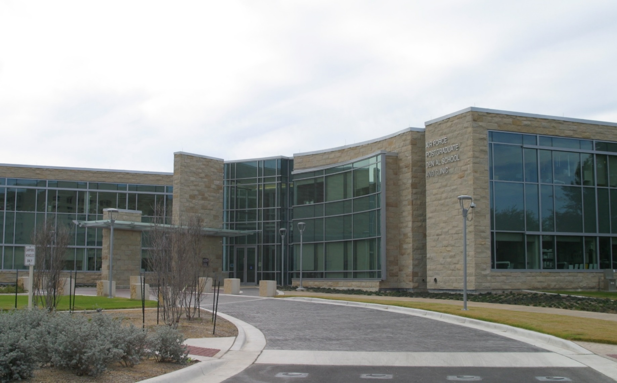
Graduate Dental Education
Air Force Postgraduate Dental School (AFPDS)
JBSA-Lackland

Slide 14
Postgraduate Training Offered
Advanced Education in General Dentistry (AEGD-1)
Specialty Training
  Comprehensive Dentistry (AEGD-2)
  Endodontics
  Dental Public Health
  Oral & Maxillofacial Pathology
  Oral & Maxillofacial Surgery
  Oral & Maxillofacial Radiology
  Orofacial Pain Residency/Fellowship
  Orthodontics
  Pediatric Dentistry
  Periodontics
  Prosthodontics
Fellowships
  Dental Health Informatics
  Dental Materials
  Infection Control / Patient Safety
  Logistics / Device Procurement
  Manpower / Strategic Resourcing
  Masters of Public Health (IHS)
  Maxillofacial Prosthetics
  OMS Facial Cosmetics
  OMS Maxillofacial Reconstruction
  OMS Craniofacial/Clefts
  OMS TMJ
  Prosthodontic Dental Materials
  SG1D
Notes:
Many of the HPSP graduating from dental school enter an AEGD-1 residency for their first year on AD. A few may enter specialty training about a year after entering active duty instead of doing an AEGD-1. Many will go on to do specialty training after completion of an AEGD-1 and serving as a general dentist for some time.
While in any of these training opportunities, you DO receive full active duty benefits and pay! These training opportunities are not like the HPSP scholarship – you are an active duty member while in the residency training program. They each have an additional ADSC incurred for receiving this training (usually 1 year of ADSC for 1 year of training). Some of these ADSCs can be served concurrently (at the same time) as your HPSP ADSC.

Slide 15

The Air Force’s Personnel Center
Comm: 210-565-0645 Elizabeth.morris.4@us.af.mil DSN: 656-0645

